Slide 1
Chapter 9
New-Product Development and Product Life-Cycle Strategies

Slide 2

New-Product Development and Product Life-Cycle Strategies
Topic Outline
New-Product Development Strategy
New-Product Development Process
Managing New-Product Development
Product Life-Cycle Strategies
Additional Product and Service Considerations
https://www.youtube.com/watch?v=BaUkuszb7dg

Slide 3
New-Product Development Strategy
Two ways to obtain new products
Acquisition refers to the buying of a whole company, a patent, or a license to produce someone else’s product
New product development refers to original products, product improvements, product modifications, and new brands developed from the firm’s own research and development
Notes:
Note to Instructor
New products are important—to both customers and the marketers who serve them. For companies, new products are a key source of growth. For customers, they bring new solutions and variety to their lives. Yet, innovation can be very expensive and very risky. New products face tough odds. According to one estimate, 90 percent of all new products in America fail. Each year, companies lose an estimated $20 billion to $30 billion on failed food products alone.

Slide 4
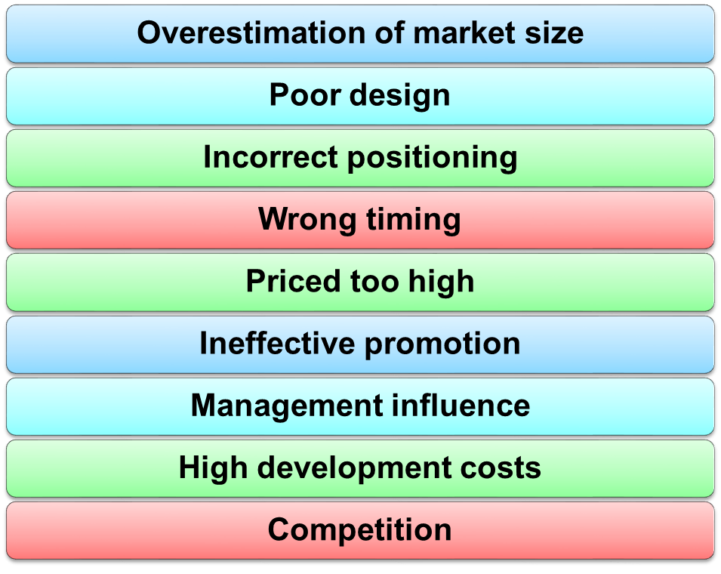
New-Product Development
Reasons for new product failure
Notes:
Note to Instructor
If you are running a marketing plan project in your class, this is a good time to ask why their project ideas might fail in the real market. You can then ask what they plan to do to prevent failure.

Slide 5
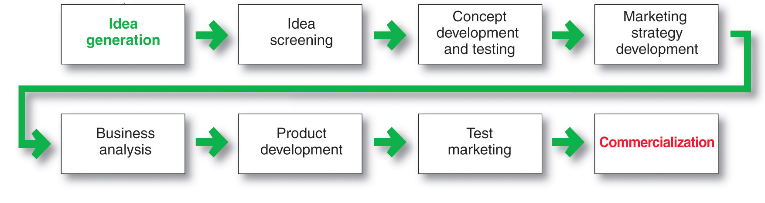
New-Product Development Process
Major Stages in New-Product Development
https://www.youtube.com/shorts/6kk6Imj_CsQ
https://www.youtube.com/watch?v=JbZW_oCUlsg

Slide 6

New-Product Development Process
Idea Generation
Idea generation is the systematic search for new-product ideas
Sources of new-product ideas
Internal
External
Notes:
Note to Instructor
Discussion Question
In groups of four come up with one ideas for a new products.
It might be helpful if you assign each group a category including kitchen products, office supplies, laptop accessories, dessert products, bathroom accessories, children’s toys, baby products, etc. Students will realize this is very difficult.

Slide 7

New-Product Development Process
Idea Generation
Internal sources refer to the company’s own formal research and development, management and staff, and intrapreneurial programs
External sources refer to sources outside the company such as customers, competitors, distributors, suppliers, and outside design firms
Notes:
Note to Instructor
It is not difficult to find examples of companies that are running contests where they ask consumers to send in ideas for new products. Dorito’s recently asked consumers to come up with a new flavor and new advertising. The Classic Mini Cooper brand was running Mini Mania’s the “Awesome New Product” Idea Contest. The grand prize winner received a 25 percent off promo code! Two second place winners will receive 15 percent off promo codes.

Slide 8
New-Product Development Process
Idea Screening
Identify good ideas and drop poor ideas
R-W-W Screening Framework:
  Is it real?
  Can we win?
  Is it worth doing?

Slide 9
New-Product Development Process
Concept Development and Testing
Product idea is an idea for a possible product that the company can see itself offering to the market
Product concept is a detailed version of the idea stated in meaningful consumer terms

Slide 10


New-Product Development Process
Concept Development and Testing
Concept testing refers to testing new-product concepts with groups of target consumers
Notes:
Note to Instructor
This Web link ties to a concept testing survey at Questionpro. It is helpful to point out to students that there are many online Web survey sites, which offer free surveys for market research. In this example, they supply a template for concept testing.

Slide 11
New-Product Development Process
Marketing Strategy Development
Marketing strategy development refers to the initial marketing strategy for introducing the product to the market
Marketing strategy statement includes:
  Description of the target market
  Value proposition
  Sales and profit goals

Slide 12
New-Product Development Process
Marketing Strategy Development
Business analysis involves a review of the sales, costs, and profit projections to find out whether they satisfy the company’s objectives

Slide 13

New-Product Development Process
Marketing Strategy Development
Product development involves the creation and testing of one or more physical versions by the R&D or engineering departments
Notes:
Note to Instructor
Many companies use their employees for product testing. Students might have worked at various consumer packaged goods companies, perhaps Quaker Oats, where they had to test cereal every day at lunch.
The text gives the example:
At Gillette, almost everyone gets involved in new-product testing. Every working day at Gillette, 200 volunteers from various departments come to work unshaven, troop to the second floor of the company’s gritty South Boston plant, and enter small booths with a sink and mirror. There they take instructions from technicians on the other side of a small window as to which razor, shaving cream, or aftershave to use. The volunteers evaluate razors for sharpness of blade, smoothness of glide, and ease of handling. In a nearby shower room, women perform the same ritual on their legs, underarms, and what the company delicately refers to as the “bikini area.” “We bleed so you’ll get a good shave at home,” says one Gillette employee.

Slide 14
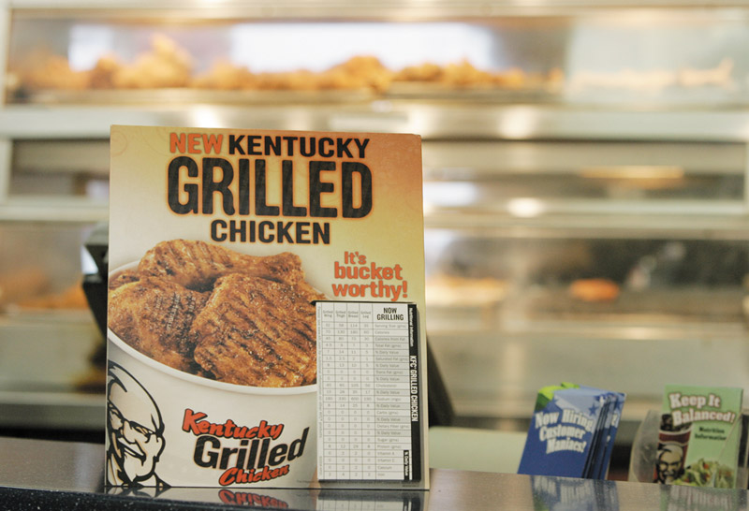
New-Product Development Process
Marketing Strategy Development
Test marketing is the stage at which the product and marketing program are introduced into more realistic marketing settings
Provides the marketer with experience in testing the product and entire marketing program before full introduction
Notes:
Note to Instructor
Here is a list of the top 10 test markets
1. ALBANY—SCHENECTADY—TROY, NY
2. ROCHESTER, NY
3. GREENSBORO—WINSTON—SALEM—-HIGH POINT, NC
4. BIRMINGHAM, AL
5. SYRACUSE, NY
6. CHARLOTTE—GASTONIA—ROCK HILL, NC/SC
7. NASHVILLE, TN
8. EUGENE—SPRINGFIELD, OR
9. WICHITA, KS
10. RICHMOND—PETERSBURG, VA
Source: Acxiom Corp., June 2004

Slide 15

New-Product Development Process
Marketing Strategy Development
Commercialization is the introduction
of the new product
When to launch
Where to launch

Slide 16
Managing New-Product Development
Successful new-product development should be:
Customer centered
Team centered
Systematic

Slide 17
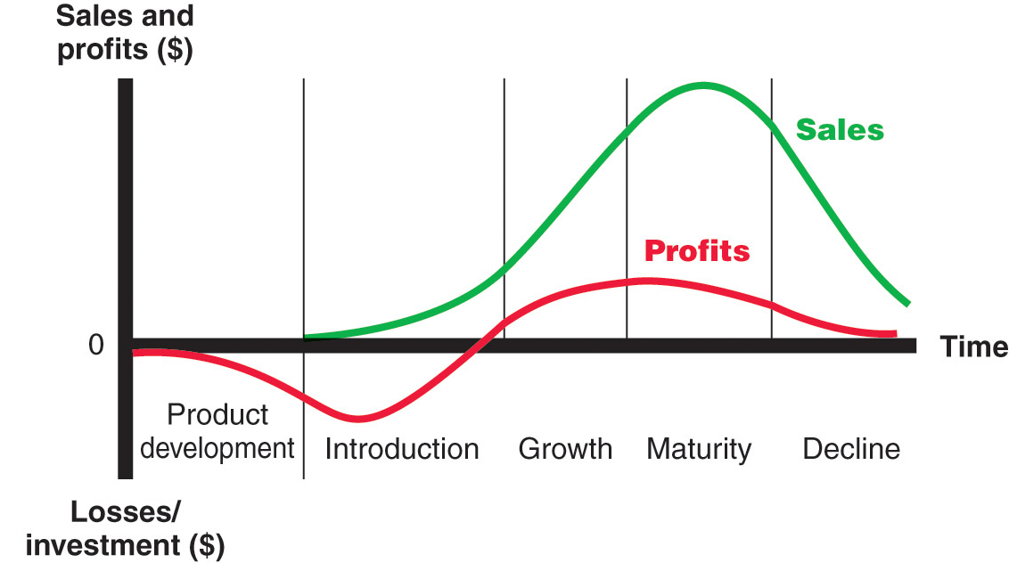
Product Life-Cycle Strategies
Product Life Cycle
Notes:
Note to Instructor
Discussion Question
Name a product at each stage of the PLC.
This concept is very new to students. See if they can identify products or product categories that are in each stage of the model. Introduction might include online movie viewing software, growth might include MP3 players, maturity might include bottled water, and decline could include soda (actually in a decline) or videotape players.

Slide 18
Product Life-Cycle Strategies
Product development
  Sales are zero and investment costs mount
Introduction
  Slow sales growth and profits are nonexistent
Growth
  Rapid market acceptance and increasing profits.
Maturity
  Slowdown in sales growth and profits level off or decline
Decline
  Sales fall off and profits drop

Slide 19
Product Life-Cycle Strategies
Introduction Stage
Slow sales growth
Little or no profit
High distribution and promotion expense

Slide 20
Product Life-Cycle Strategies
Growth Stage
Sales increase
New competitors enter the market
Price stability or decline to increase volume
Consumer education
Profits increase
Promotion and manufacturing costs gain economies of scale

Slide 21
Product Life-Cycle Strategies
Maturity Stage
Slowdown in sales
Many suppliers
Substitute products
Overcapacity leads to competition
Increased promotion and R&D to support sales and profits
Notes:
Note to Instructor
Cars are very mature products so companies are always coming up with new models and features. This is a link to a very funny YouTube ad about a new car product.

Slide 22
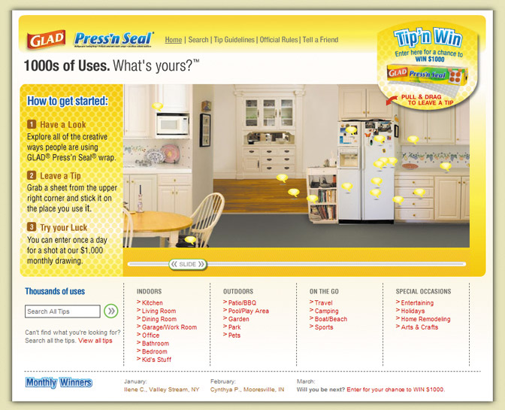

Product Life-Cycle Strategies
Maturity Stage Modifying Strategies
Market modifying
Product modifying
Marketing mix modifying
Notes:
Note to Instructor
This link is for 1000 Uses of Glad Web site. It is described below, and in the book, as a way to modify the product.
In modifying the market, the company tries to increase the consumption of the current product. It may look for new users and new market segments. The manager may also look for ways to increase usage among present customers. The company might also try modifying the product—changing characteristics such as quality, features, style, or packaging to attract new users and to inspire more usage. It can improve the product’s styling and attractiveness. It might improve the product’s quality and performance—its durability, reliability, speed, taste.

Slide 23
Product Life-Cycle Strategies
Decline Stage
Maintain the product
Harvest the product
Drop the product

Slide 24
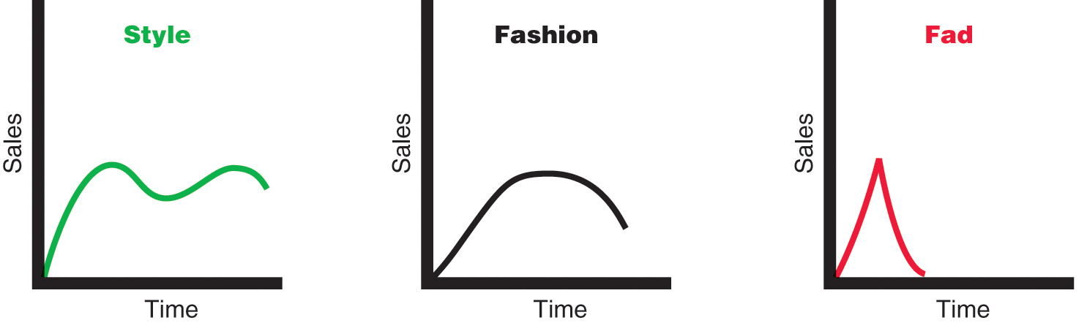
Product Life-Cycle Strategies
Notes:
Note to Instructor
Style is a basic and distinctive mode of expression.
Fashion is a currently accepted popular style in a given field.

Slide 25
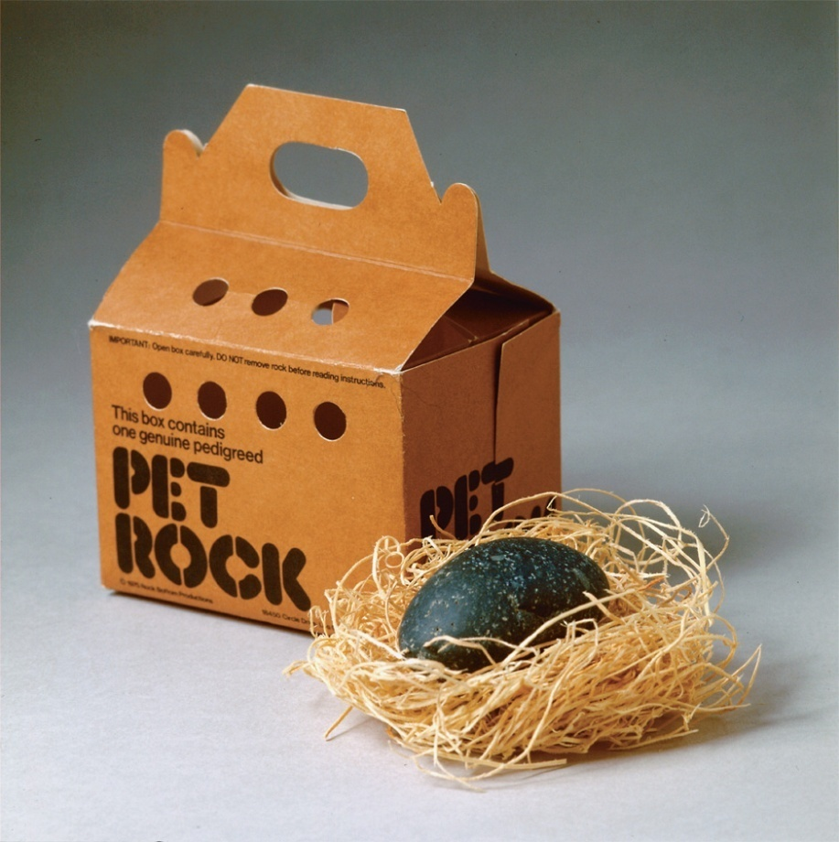
Product Life-Cycle Strategies
Fads are temporary periods of unusually high sales driven by consumer enthusiasm and immediate product or brand popularity

Slide 26

All rights reserved. No part of this publication may be reproduced, stored in a retrieval system, or transmitted, in any form or by any means, electronic, mechanical, photocopying, recording, or otherwise, without the prior written permission of the publisher. Printed in the United States of America.
Copyright © 2010 Pearson Education, Inc.
Publishing as Prentice Hall

